Slide 1


China's Arctic Shipping Evolution: From Episodic Transits to Regular Container Services
Harbin Engineering University
School of Economics and Management
Prof. Gao Tianming, Harbin Engineering University
Dr. Vasily Erokhin, RUDN University

Slide 2

Permits for entry to the Northern Sea Route for Chinese vessels
 | 2015 | 2016 | 2017 | 2018 | 2019 | 2020 | 2021 | 2022 | 2023 | 2024 | 2025
Total permits issued | 715 | 718 | 662 | 792 | 799 | 1014 | 1229 | 1182 | 1219 | 1312 | -
Number of permits for foreign vessels | 125 | 144 | 107 | 91 | 100 | 157 | 158 | 56 | 116 | 117 | -
Number of permits for Chinese vessels | 2 | 9 | 16 | 11 | 15 | 22 | 30 | 10 | 22 | 20 | 23
Number of Chinese vessels | 2 | 7 | 16 | 9 | 13 | 17 | 27 | 7 | 19 | 18 | 23

Slide 3
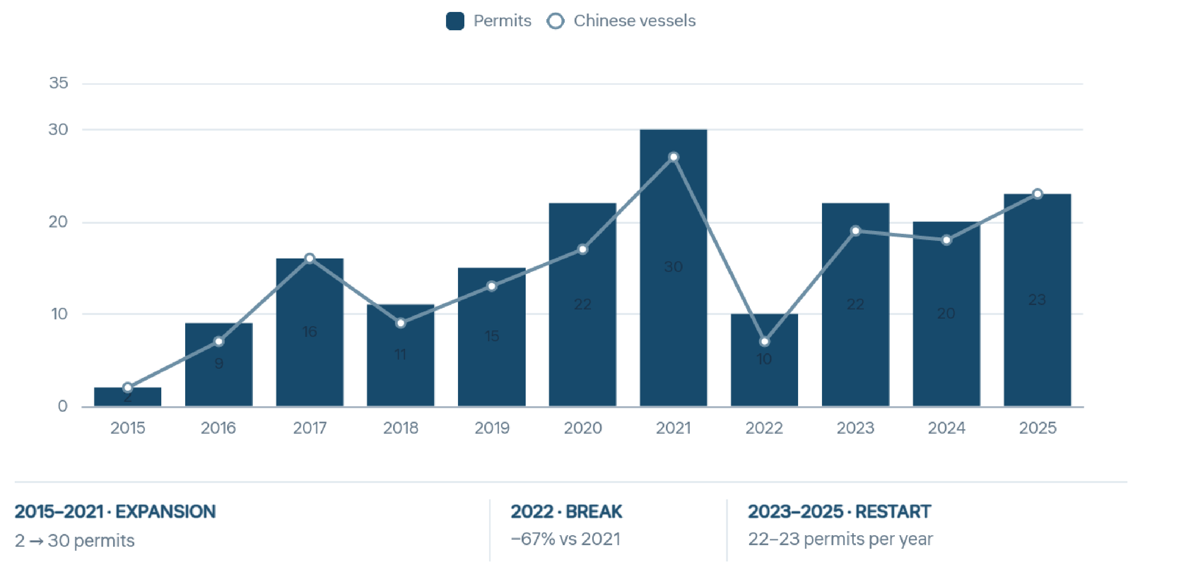
China: Permits and vessels - three periods

Slide 4
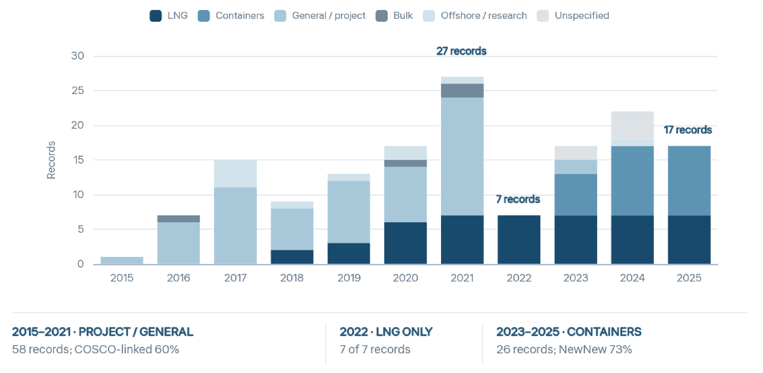
China: listed vessel records by cargo role

Slide 5
expanding the NSR into the Trans-arctic transport corridor
Spheres | Key aspects | Plans and perspectives
Current activities and growth | Launch of the multimodal route 'Arctic Express No. 1' (China – Arkhangelsk – Moscow). A successful example – the passage of a container ship from St. Petersburg to Shanghai in 23 days. | During 2025 – 20 voyages and 10 port calls as part of the service to Arkhangelsk. Addition of the ports of Murmansk and Pevek to the route network. Goal: to reduce transportation time to 18-19 days.
Strategic project of the TATC | Evolution of the NSR into a large-scale route St. Petersburg – Kaliningrad – Murmansk – Arkhangelsk – Vladivostok. Goal: to become the foundation for Russia's economic growth and national security in the Arctic. | Target cargo flow of up to 109 million tons per year by 2030. Creation of a financial, economic, and organizational model for the Northern Sea Route transport and logistics corridor (supervised by Rosatom). Establishment of the Arctic Development Investment Fund and a project office with VEB.RF.
Development of infrastructure | Repurposing part of the Murmansk port; development of the ports of Arkhangelsk, Vladivostok, Sakhalin, and Kamchatka. Development of railway and highway arteries leading to the ports. | Creation of a seamless transport system (ports, railways, roads, inland waterways). A project to create comfortable living conditions for people in the Arctic.

Slide 6
expanding the NSR into the Trans-arctic transport corridor
Spheres | Key aspects | Plans and perspectives
Fleet and technologies | The backbone of the fleet consists of nuclear and diesel-electric icebreakers (Atomflot). Shipbuilding problems: the need to order ships outside Russia, establish international cooperation, and develop Russian shipbuilding. | Focus on the construction of Arc-7 class container ships. Introduction of unmanned and autonomous technologies for ships and rail trains. Planning of scheduled convoy navigation by 2040.
Management and digitalization | The issue of appointing a single infrastructure operator for the TATC is under discussion. Rosatom's area of responsibility: 3,000 nautical miles of the NSR from the Kara Gates to the Bering Strait. | Creation of a national digital transport and logistics platform. Objectives of the platform: reducing paper document flow, converting document flow to electronic form.
International collaboration | Interest and participation of partners from China, Belarus, the UAE, and India. Intergovernmental formats for cooperation on the NSR have been established with China and India. | Proposals to international operators to invest in Russian companies with capital, technology, and fleet. Priority is given to joint capital and the adaptation of Chinese technologies to Arctic conditions.

Slide 7

Summary
China has grown from an episodic NSR user into the route’s largest foreign shipping participant (23 permits and 23 vessels in 2025).
Yamal LNG shipments provided continuity throughout the decade - since 2023, growth has been driven by regular Russia–China container services.
Container shipping is booming: Chinese operators made 7 container voyages in 2023, 11 in 2024 and 14 in 2025. The NSR set a record of 23 container transits in 2025.
TATC: China is the corridor’s central foreign partner — cargo, capital, technology and fleet behind the 109 Mt/year target.
China–Europe Arctic Express: from trial voyage (Sept 2025) to regular weekly service (Aug 2026) — China–Europe in 20 days, half the Suez time, up to 50% lower CO₂ emissions.
Ideal for China’s high-value exports: power batteries, photovoltaic modules, energy-storage systems, NEV components, e-commerce cargo.
Year-round outlook: Rosatom–NewNew Shipping JV to build five Arc7 container ships (4,800+ TEU, lead ship 2027, home port Murmansk). More ice-class vessels on the China–St Petersburg line in 2026–2027.
Bilateral roadmap targets 20 Mt of annual Russia–China NSR cargo by 2030.

Slide 8
Thank you for your attention!
Harbin Engineering University
School of Economics and Management
Gao Tianming: gaotianming@hrbeu.edu.cn
Vasily Erokhin: erokhin-vl@rudn.ru

