Slide 1
The Arctic Issue and Türkiye
- Cihat Yaycı, Retired Admiral of the Turkish Navy
Assoc. Prof., PhD, Istanbul Topkapı University

Slide 2
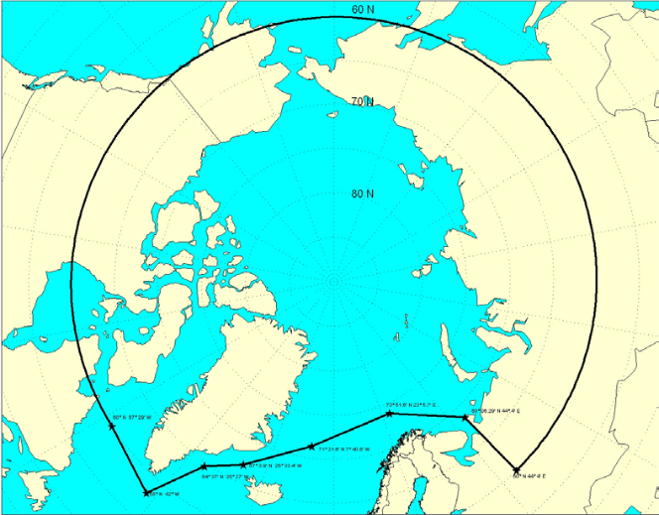
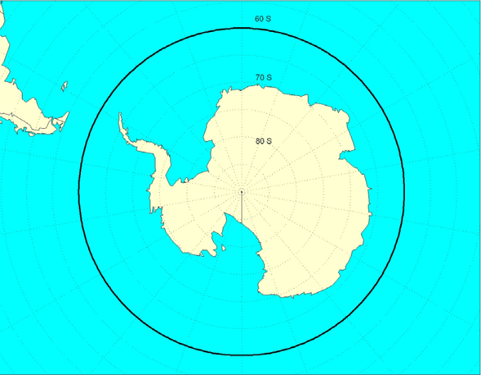
Arctic
Antarctica
The pole is defined as "each of the two points where the Earth's axis is considered to intersect the Earth's surface." The polar regions are divided into two: the Arctic (North Polar Region) and Antarctica (South Polar Region). While Antarctica is a frozen continent surrounded by oceans, the Arctic is a frozen ocean surrounded by continents.

Slide 3
IMPORTANCE OF ARCTIC
Key Features | Details
Economic Potential | Estimated high economic value of undiscovered reserves of water, oil, and natural gas.
Mineral Wealth | Presence of minerals worth approximately $1 trillion, including zinc, nickel, diamonds, palladium, and platinum.
Tourism Growth | Rapidly becoming a popular tourist destination.
Northern Sea Route | Saves approximately 4,500 nautical miles through the "Northern Sea Route," which transports over 1 million tons of cargo annually.

Slide 4
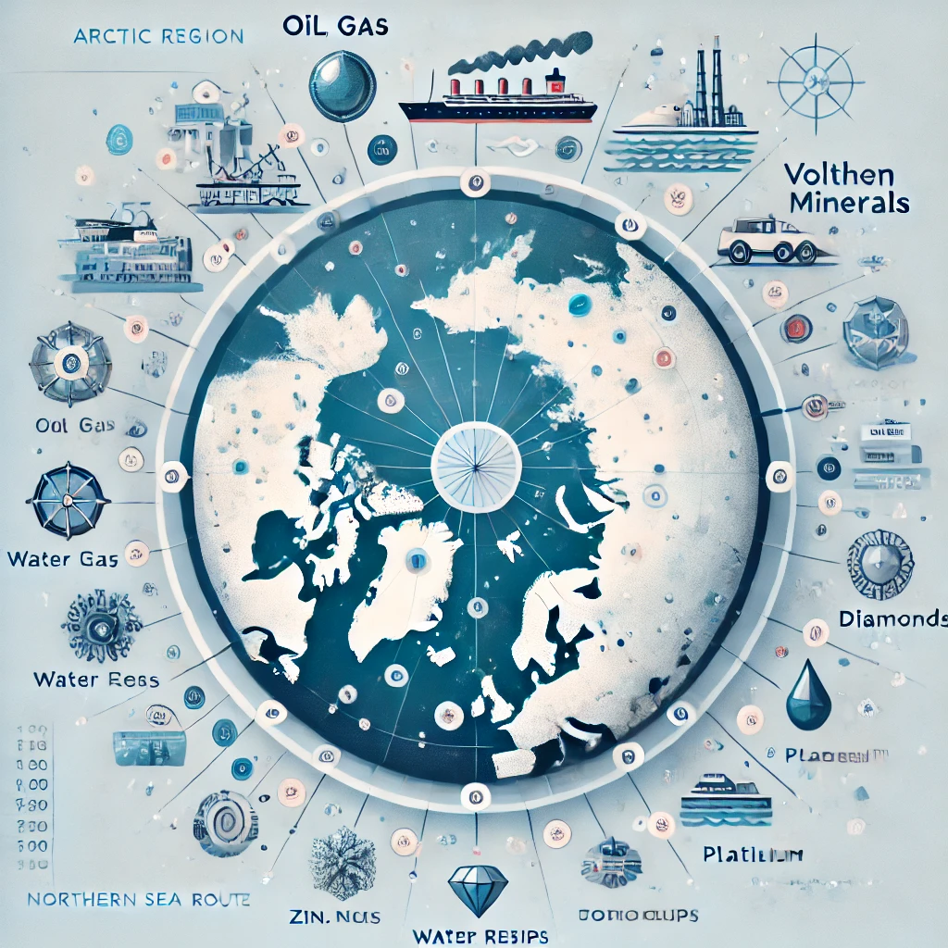
IMPORTANCE OF ARCTIC
The Arctic region is home to 13 percent of untapped oil resources, 30 per cent of natural gas and 20 per cent of liquid natural gas. It is estimated that 84 per cent of these resources are offshore. Due to the abundance of raw materials in this region, geologists have named the Arctic region ‘Ali Baba's Cave’

Slide 5
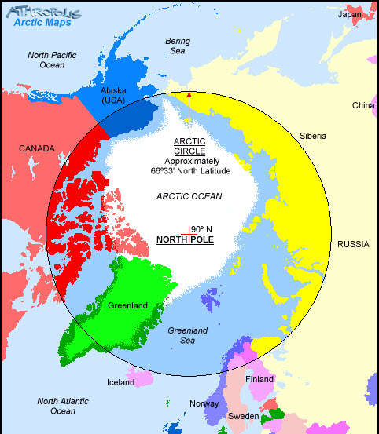
ARCTIC
If the Arctic Region is to be expressed on the basis of the Arctic circle; It covers a part of the territory of Russia, Canada, Denmark, USA, Norway, Sweden, Finland and Iceland. This region is considered as the wider Arctic.

Slide 6
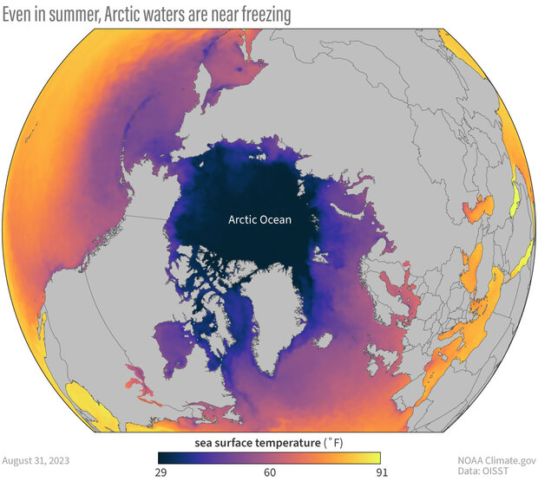
ARCTIC
Known as the Arctic Five, the countries that have borders and claim rights to the Arctic Region are the USA, Russia, Norway, Canada and Denmark. Apart from these countries, Iceland, Sweden, Finland and Far East countries Japan, China, South Korea and India are also closely interested in the Arctic Region.

Slide 7
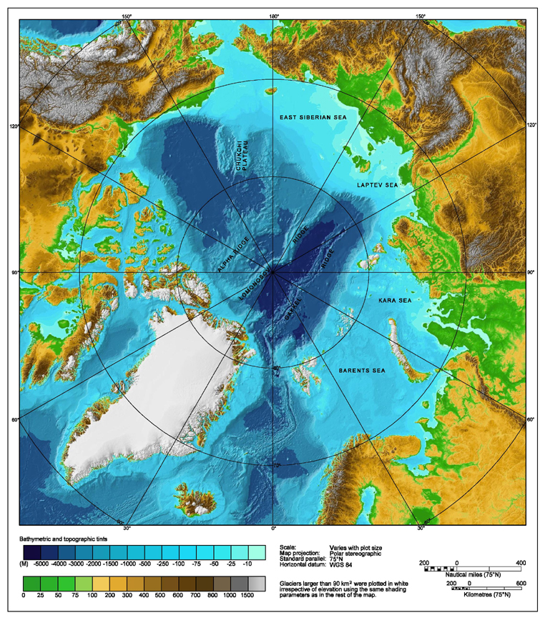
Legal Status of the Arctic Region
In the current conjuncture where sea ice is decreasing in the Arctic region due to climate change, and in parallel with this, interest in energy reserves, fishing potential, new sea routes and tourism in the region has increased, studies on the status and future of the Arctic have also gained momentum.

Slide 8
Legal Status of the Arctic Region
Topic | Details
Resolved Dispute | Norway and Russia resolved continental shelf and Svalbard Treaty interpretation issues in Oslo (2010).
Pending Claims | Denmark, Norway, and Russia submitted claims to the UN for extended continental shelves. Canada is preparing its submission.
Lomonosov Ridge Dispute | Russia claims it as an extension of its mainland, opposed by the USA, Denmark, Canada, and Norway.
Northwest Passage | Canada's sovereignty claim over the passage and maritime boundaries in the Beaufort Sea remain unresolved with the USA.
Hans Island Dispute | Ongoing sovereignty negotiations between Canada and Denmark.
Agreements by Coastal States | - Canada & Denmark: Continental shelf boundary (1973). - Denmark & Iceland: Continental shelf and fishing zone (1997). - Denmark & Norway: Jan Mayen agreements (1995, 1997). - Denmark & Norway (Svalbard): Continental shelf and fishing zone (2006).
Iceland and Norway Agreements | Exclusive Economic Zone (1980) and continental shelf/mutual boundaries (1981).
Norway and Russia Agreements | Expanded maritime areas (2007) and Barents Sea delimitation (2010), effective in 2011.
Russia and USA Agreement | Single maritime boundary agreement signed in 1990.

Slide 9
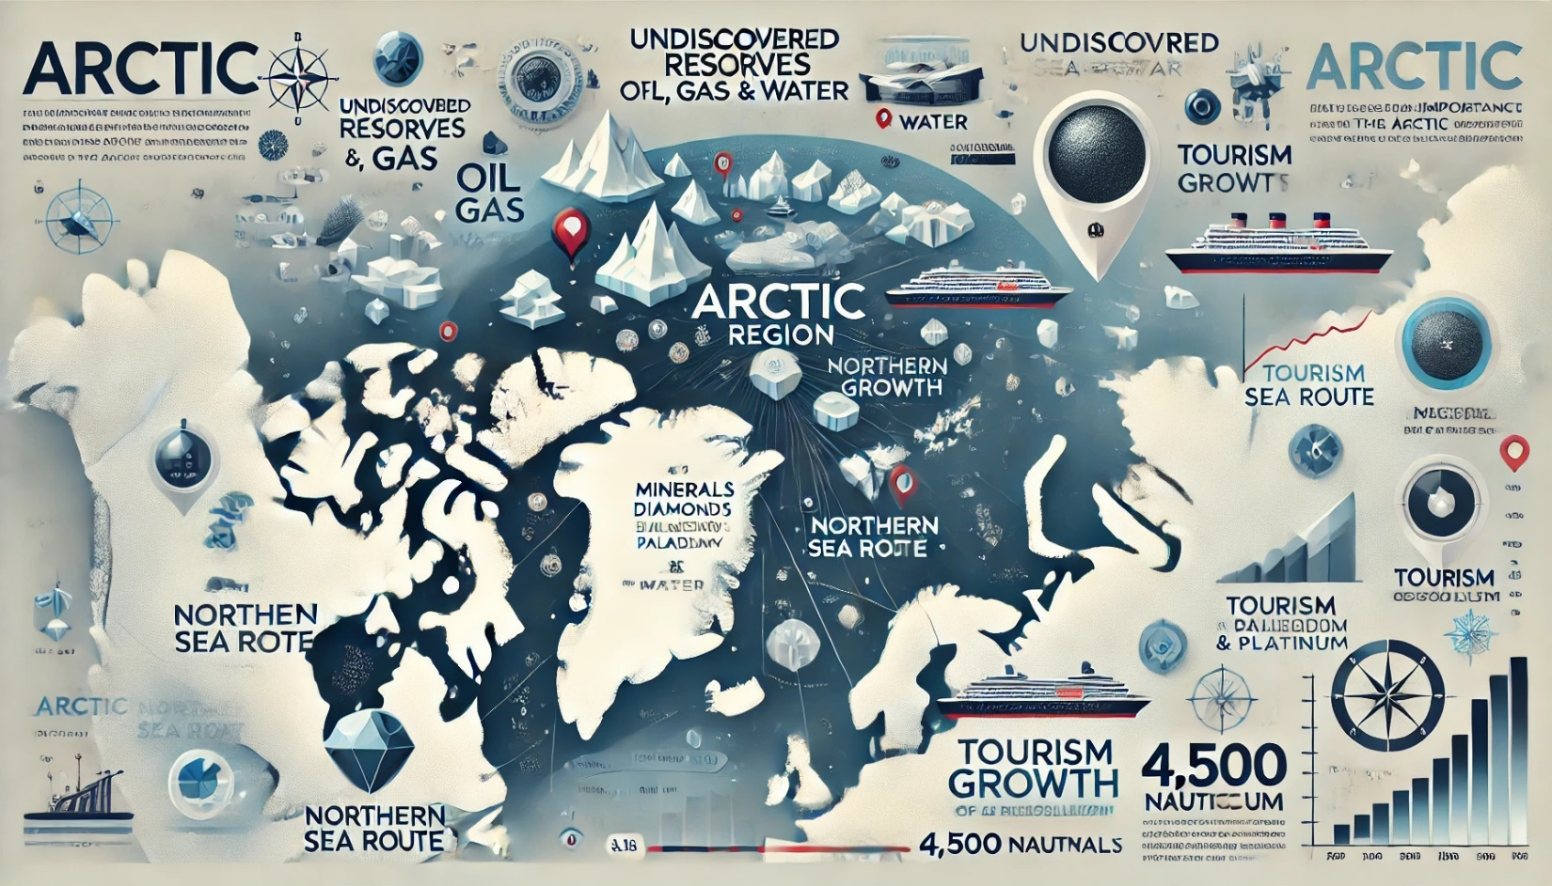
Globalisation of the Arctic Region
It is estimated that one third of the world's existing natural gas reserves and 10 per cent of the world's oil reserves are in the Arctic Region. There are also rich zinc, nickel, copper, gold, iron and palladium resources. On the other hand, new fishing areas will also emerge. Melting is expected to lead to an increase in the amount of fish and microorganisms. In 2017, a treaty was signed with the participation of the polar countries, the EU, China, Japan and the Republic of Korea, and it was agreed that there would be no commercial fishing in the central regions of the pole for 16 years.

Slide 10
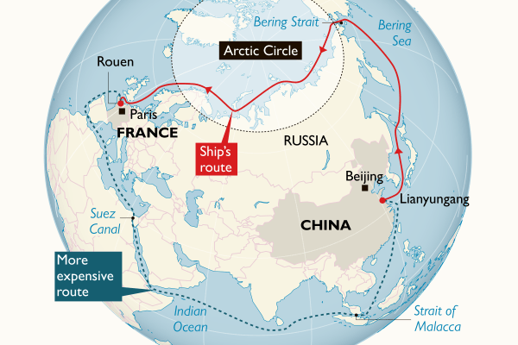
Globalisation of the Arctic Region
For years, the Arctic region has given the appearance of an area where the littoral states have cooperated. However, the increasing interest of extra-regional actors causes potential conflicts of interest. China is one of these countries. China became an observer member of the Arctic Council in 2013 and published its first policy document on the Arctic in 2018. In this document, it defined itself as an important stakeholder and a ‘semi-polar country’. In recent years, there has been a marked increase in China's interest and activities towards the region.

Slide 11
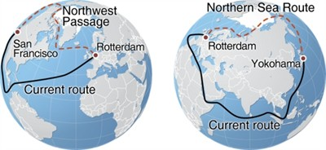

Slide 12
ARCTIC COUNCIL

Slide 13
Svalbard (Spitzbergen) Islands and the 1920 Svalbard Treaty
The Svalbard Treaty (signed in 1920) is an international agreement that recognizes the sovereignty of Norway over the Svalbard archipelago, while granting equal rights to all signatory states to engage in economic activities such as fishing, mining, and research on the islands. The treaty also ensures that the archipelago remains demilitarized.
Importance:
It establishes Svalbard as a unique territory with specific legal and economic regulations.
It promotes international cooperation by allowing various countries to exploit resources in the region under Norwegian law.
It plays a significant role in Arctic geopolitics, influencing territorial disputes and resource claims, especially with neighboring Russia.

Slide 14
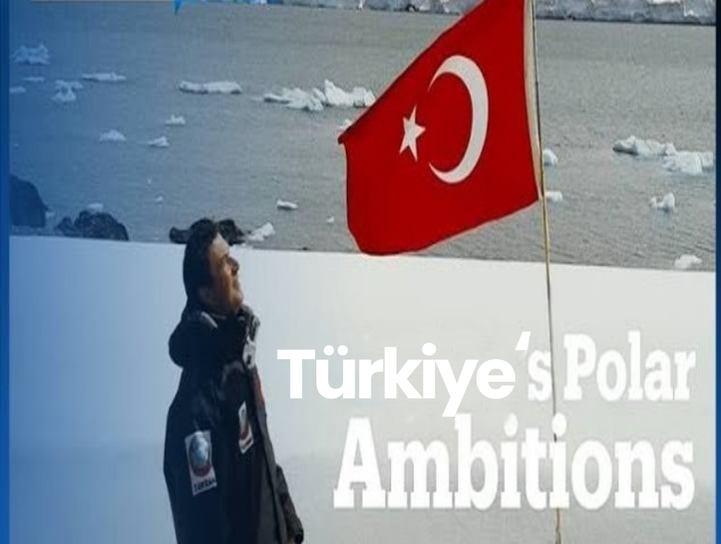
ARCTIC and TÜRKİYE
Türkiye has rights arising from international law in the Arctic region as it is a ‘common heritage of humanity’.

Slide 15
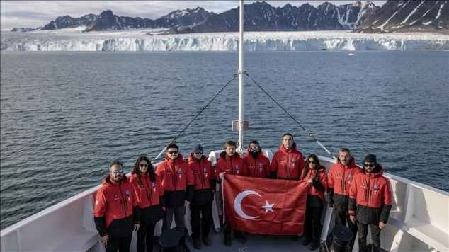
ARCTIC and TÜRKİYE
Currently, Türkiye closely monitors the activities within the Arctic framework. In this context, an application was made in 2015 to become a member of the Arctic Council with observer status, but no result was obtained.

Slide 16
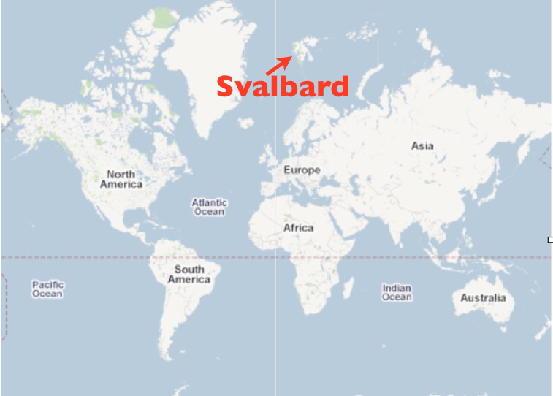
ARCTIC and TÜRKİYE
The Republic of Türkiye became a party to the Svalbard Treaty, to which even countries such as Afghanistan, Bulgaria, Egypt, Greece, India, Saudi Arabia, Greece, India, India and Saudi Arabia are parties, on 17 October 2023 within the framework of its rights and interests in the world seas, in order to have potential rights, taking into account that the new sea transport routes expected to be opened with the melting of the glaciers will affect maritime trade and the possible economic gains in the future, even if not today, in the new lands that have emerged or will emerge.

Slide 17
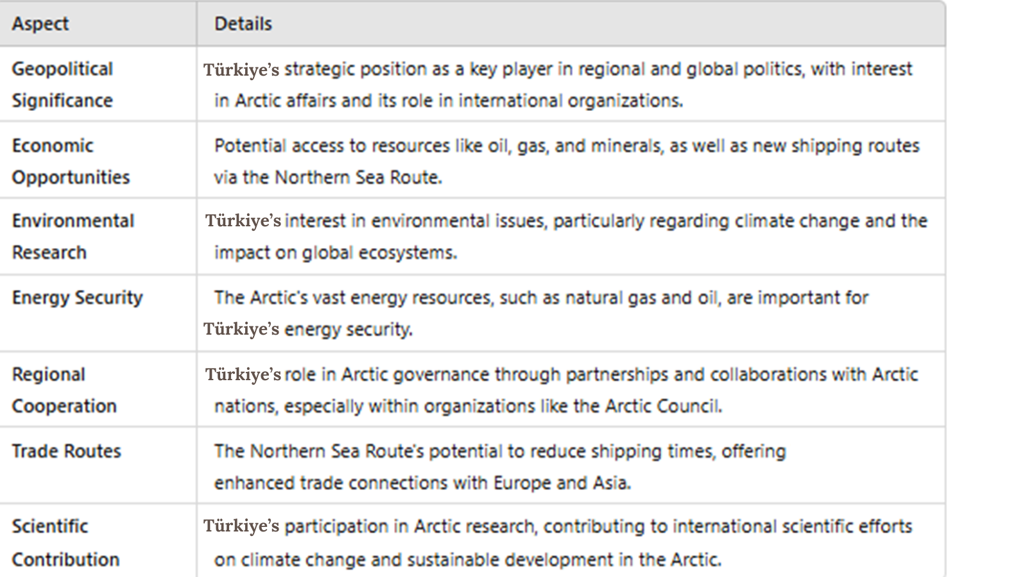
Importance of the Arctic Region for Türkiye

